Slide 1
Introduction to Data Analytics & Machine Learning
GDSC NIIT UNIVERSITY
Arnav Ignatius
Data Analytics Lead
16th April 2023
Mikhail Martins
AI/ML Lead

Slide 2
Table of contents
About Data Analytics
Data Exploration & Visualization
1
2
Preprocessing & Cleaning
Analysis & Modeling
3
4
Necessity and how it helps
Importance, Applications in various domains
Preparing, cleaning, dealing with inconsistencies
Statistics, ML, Conversion to meaningful results

Slide 3
Table of contents
Data: Ethics & Privacy
Tools
5
6
Demonstration
7
Kaggle, Google Looker Studio, Tableau, PowerBI
Collection, storage, analysis & privacy concerns
Using Jupyter Notebook

Slide 4
The Problem
We as humans, do not know everything!

Slide 5
The Solution
Find out!

Slide 6
1
About Data Analytics

Slide 7
Overview of Data Analytics
Process of examining data in order to draw meaningful conclusions
Identifying patterns, trends and relationships in data
Utilizing these insights to make decisions that are profitable

Slide 8
Data
Analytics
Overview of Data Analytics
What data?
How do we collect it?
Is it correct data?
Is it structured?
Is it clean ?
What is the required outcome?
Asking the right questions
Exploring the right data
Analyzing the data
Drawing simple conclusions

Slide 9
Overview of Data Analytics
Why is it important?
To make better decisions
Where can it be used?
Healthcare, Finance, Marketing, Manufacturing, Logistics…

Slide 10
Data Exploration & Visualization
2

Slide 11
Data Exploration & Visualization
EDA
Visualization
How?
Summarize main characteristics
Identify obvious errors, outliers, anomalies, patterns before making assumptions
Goes hand in hand with EDA
Scatter plots, Histograms, Box plots etc.
Python with massive support of libraries such as Matplotlib, Seaborn
R having built in support for statistical and scientific computing

Slide 12
Data Exploration & Visualization
Why explore?
Why visualize?
Identify whether the data is correct
Test its validity
Find out descriptive features like mean, median, mode understand the dataset better
Instantly identify patterns & trends
Advantage of the human eye
Straightforward way to represent insights for the non-technical
Create dashboards for real-time monitoring

Slide 13
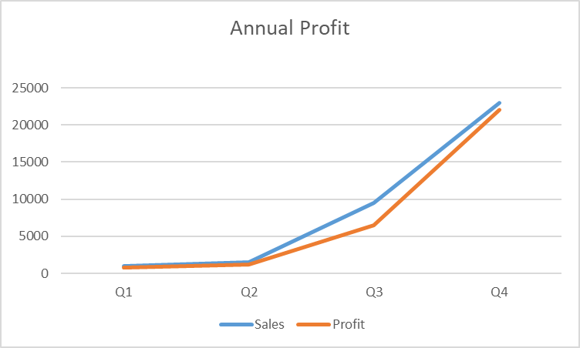
Data Exploration & Visualization
Quarter | Sales | Profit
Q1 | 1000 | 800
Q2 | 1500 | 1200
Q3 | 9500 | 6500
Q4 | 23000 | 22000

Slide 14
Correlation
Correlation is a statistical metric for measuring to what extent different variables are interdependent
Over time, if one variable changes how does this affect change in the other variable?
This is important to identify the relationship between any two features of the dataset

Slide 15
3
Preprocessing & Cleaning

Slide 16
Preprocessing & Cleaning
Extract: from 1 or more sources
Transform: into proper structure or desired format
Load: onto a target location, file or database

Slide 17
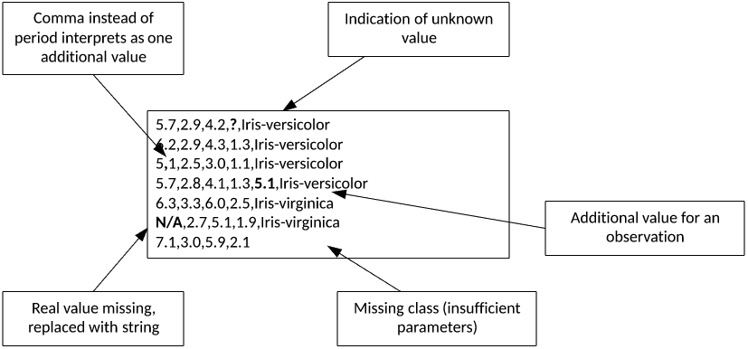
Preprocessing & Cleaning
Source : https://developer.ibm.com/developer/default/tutorials/ba-cleanse-process-visualize-data-set-1/images/image002.png

Slide 18
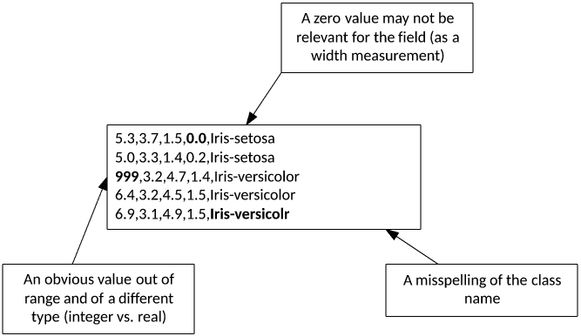
Preprocessing & Cleaning
Source: https://developer.ibm.com/developer/default/tutorials/ba-cleanse-process-visualize-data-set-1/images/image005.png

Slide 19
Preprocessing & Cleaning
Data normalization is a technique used to transform the values of a dataset into a common scale.
Many normalization methods like Min-Max normalization, Z-score normalization, Decimal Scaling etc.
Min-Max : scales features in the range of 0 to 1

Slide 20
Analysis & Modeling
4

Slide 21
Analysis & Modeling
Diagnostic Analysis: Why did this happen?
Predictive Analysis: What will happen most likely ?
Prescriptive Analysis: What can we do next?

Slide 22
Regression
Regression is a statistical tool that helps determine the cause and effect relationship between the variables.
It determines the relationship between a dependent and an independent variable.
Consider an equation representing linear regression: y = Mx + C

Slide 23
Machine Learning
Supervised ML: Uses labeled data
Unsupervised ML: Uses unlabeled data
Reinforcement Learning: Uses unlabeled data but is given feedback when it is correct or incorrect

Slide 24
Supervised Learning
Classification Models: Identify the category of the input whether it is belonging to that category or not
Yes or no, red or blue, human or animal
Logistic Regression, Decision Tree, SVM, Random Forest

Slide 25
Supervised Learning
Regression Models: Predict the continuous valued output variable based on the relationship of dependent on independent variable
Linear Regression, Multiple Linear Regression, Decision Tree, Polynomial Regression

Slide 26
5
Data: Ethics & Privacy

Slide 27
Data: Ethics & Privacy
Ownership – An individual owns their personal information
Transparency – People have a right to know how you plan to collect, store and use their data
Intention – Why you need it? What you’ll gain from it? What changes you can make with it after?

Slide 28
Data: Ethics & Privacy
Outcomes - Even when intentions are good, the outcome of data analysis can cause inadvertent harm to individuals or groups of people.
Privacy - Even if a person gives you consent to collect, store, and analyze their personally identifiable information that doesn’t mean they want it publicly available.

Slide 29
Tools
6

Slide 30
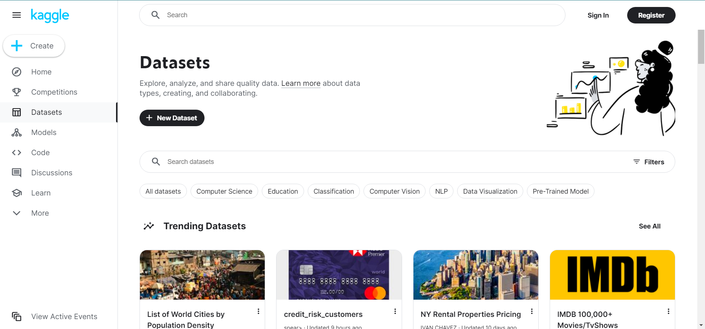
Kaggle.com

Slide 31
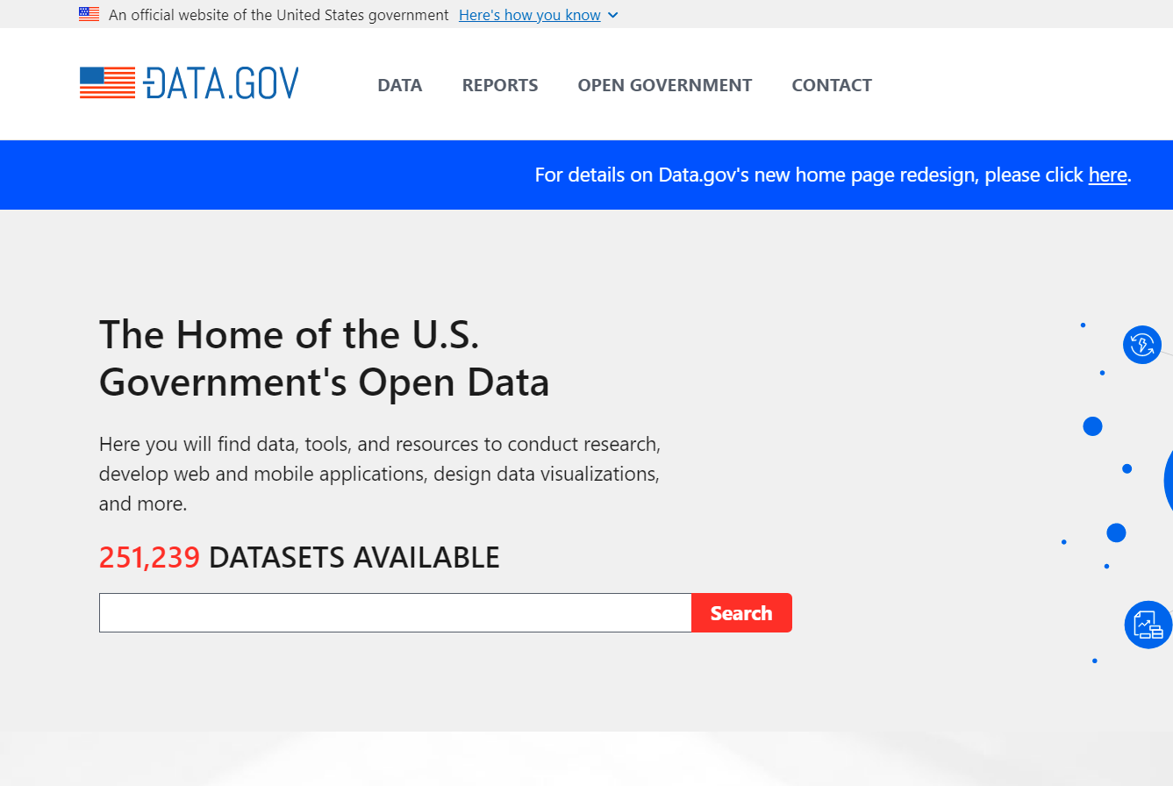
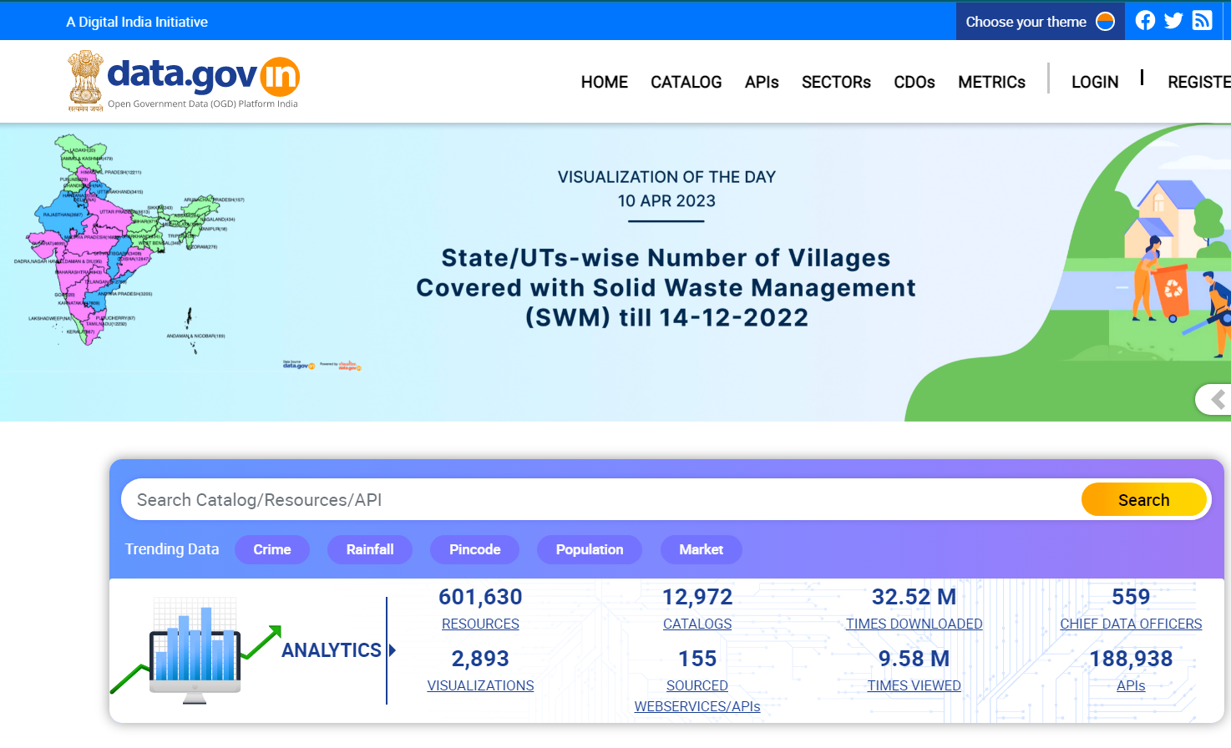
Data.gov Data.gov.in

Slide 32
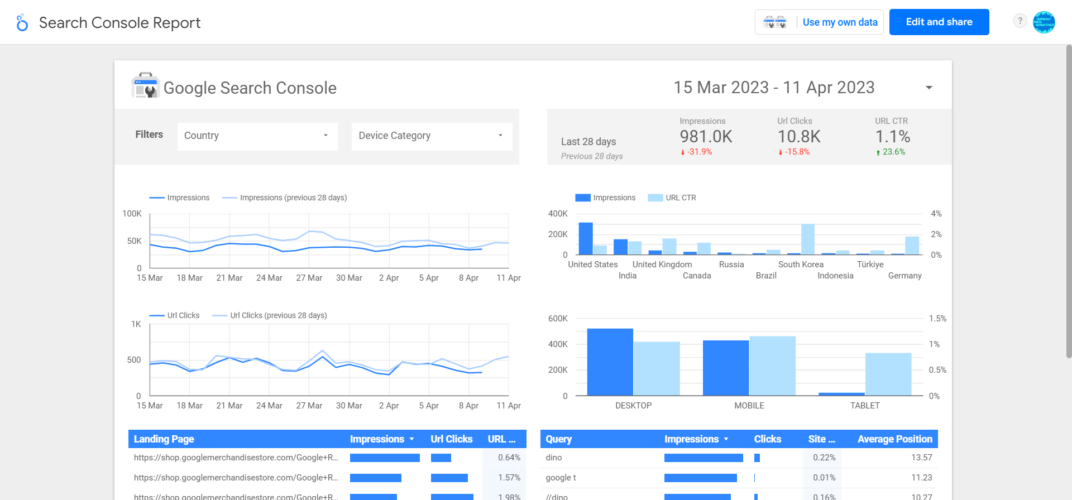
Looker Studio by Google

Slide 33
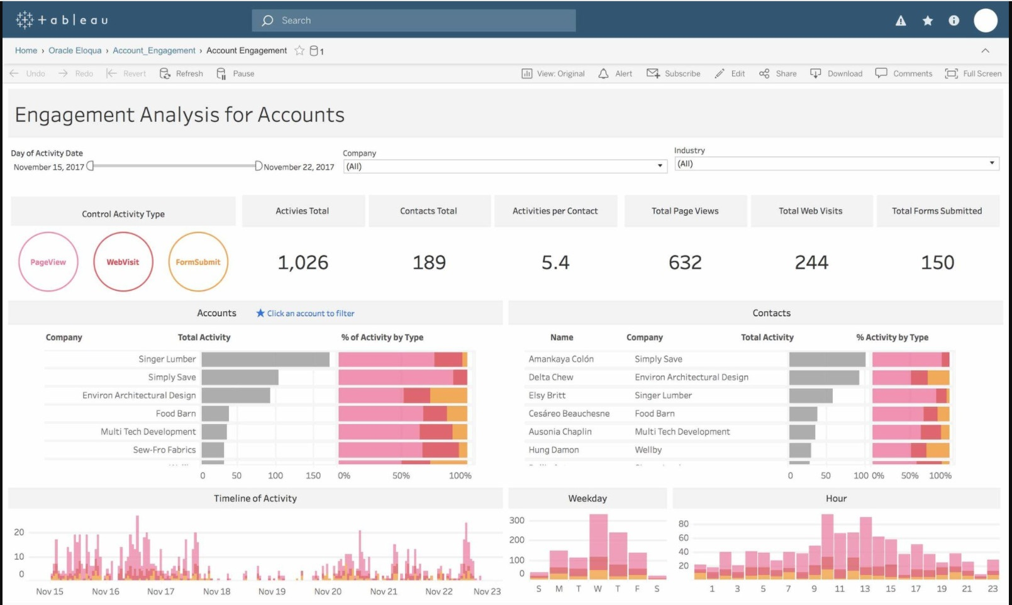
Tableau

Slide 34
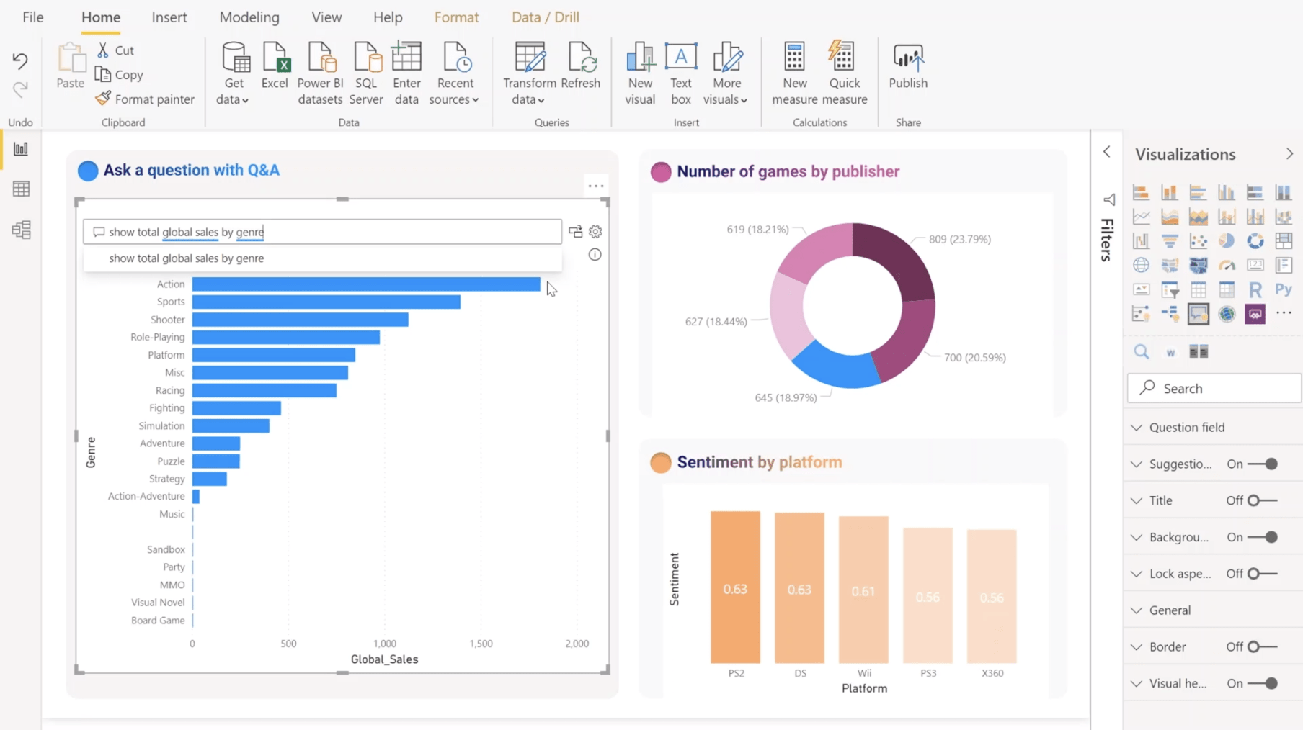
Power BI by Microsoft

Slide 35
7
Demonstration

